Slide 1
Techshop
Authors: Móricz János Milán, Lévai Levente József

Slide 2
The problem
Many webshops are overcrowded with information and they are hard to navigate.
The solution
Techshop
Our webshop is easy to navigate and clean looking.

Slide 3
Functions of the program for users
Registration
Login
Easy checkout
Writing reviews
Search products by name
The user can cancel his order by contacting support
Can browse between entries

Slide 4
Functions of the program for admins
Login
Create, edit and delete products
Edit and delete users
Delete orders
Create, edit and delete entries
Delete reviews from the product

Slide 5
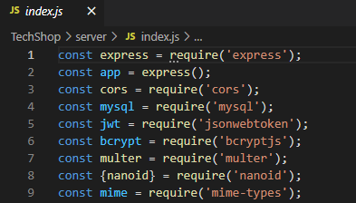

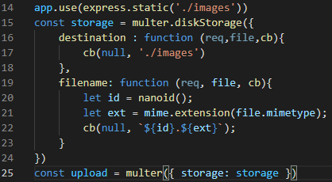

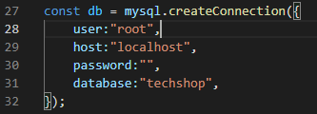
Backend
Node 16.13.1.v.
Modules
Express
Cors
Multer storage with nanoid
Database connection
JWT token
Bcrypt
Authentication

Slide 6
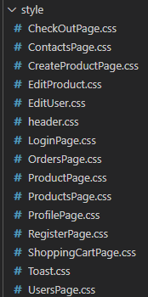
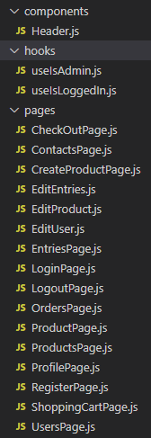
Frontend
React 17.0.2.v.
Bootstrap
CSS
Dependencies
Roles

Slide 7
Database
MySQL
Loading data
For all tables
5 tables
phpMyAdmin

Slide 8
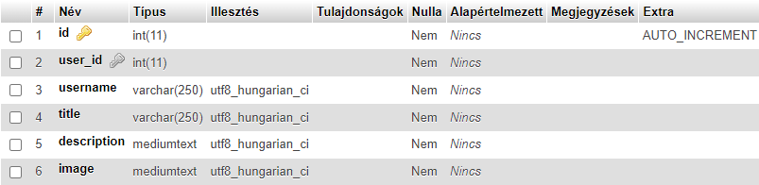
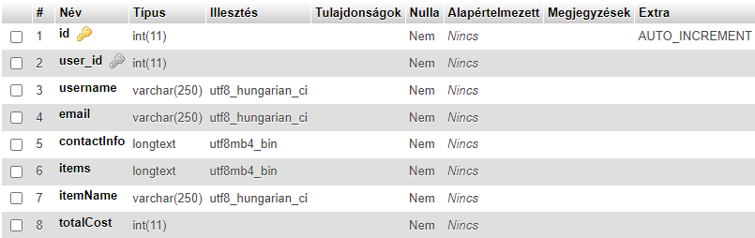
Models
entries
orders

Slide 9
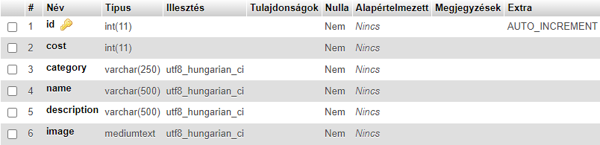
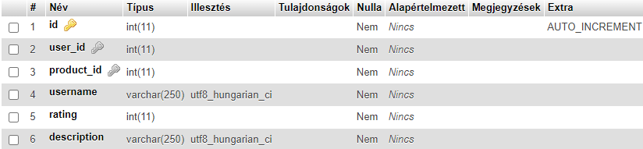
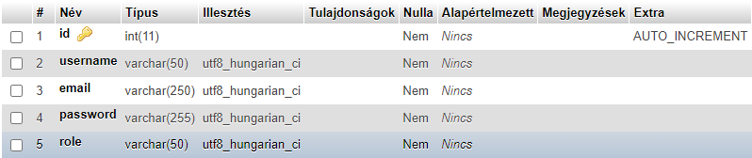
product
reviews
user

Slide 10
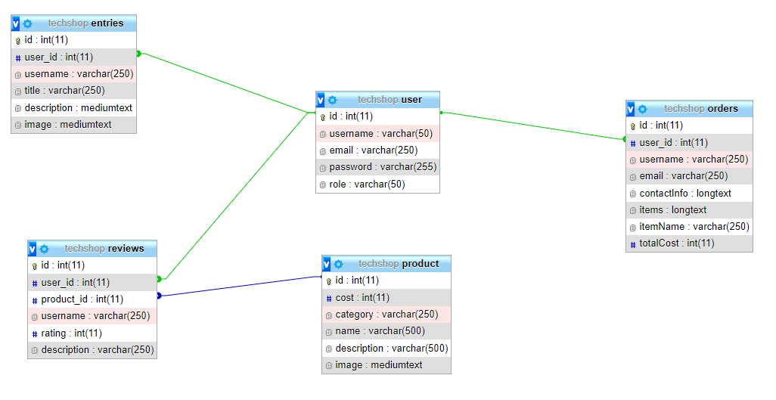
Table connections

Slide 11
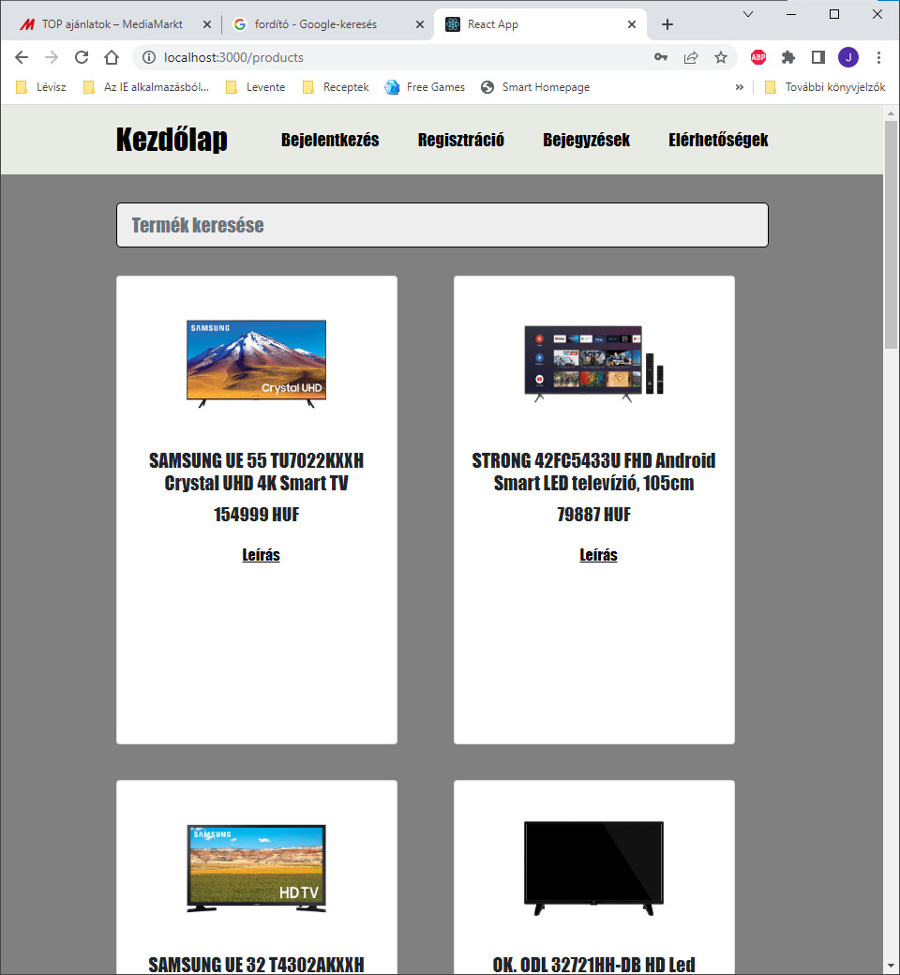
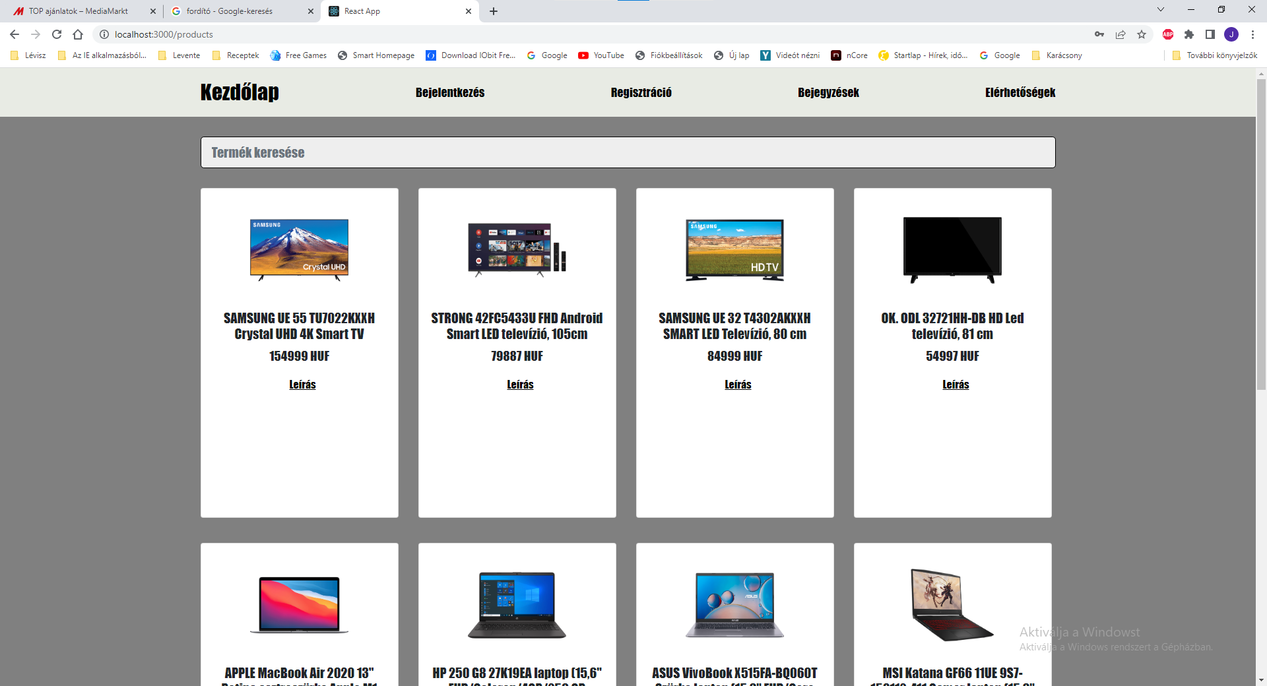
Responsivity

Slide 12
Tests
Frontend
Backend
Axios and form testing.
Postman collection testing for every request.

Slide 13
Teamwork
GitHub
Discord
Facebook
Google Drive

Slide 14
Teamwork tasks
Móricz János Milán
Backend: Creating database connection, multer storage, GET, DELETE, PUT, POST requests, JWT token, bcrypt
React: Contexts, register, login, ckeckout, orders, create product, edit entries, edit products, edit user, entries, logout, products, product, profile, shopping cart, users pages, routing, Bootstrap, useIsAdmin, useIsLoggedIn
Backend testing: Postman collection tests

Slide 15
Teamwork tasks
Lévai Levente
React: Contacts page
React test: Axios and form tests,
Style: CSS files, Bootstrap
Database: MySQL database on a phpMyAdmin

Slide 16
The future
Own domain
Online payment
Chat bot
Expanding the search option
Accessibility options

Slide 17
Techshop demo

